Slide 1

COMPASS AI
Operationalising the Science Education Strategy for an AI-Augmented Future

Slide 2

The Core Challenge
Universities design degrees for a labour market that existed three to five years ago. Generative AI has made this gap dangerous.
The Missing Metric: We lack a fast, repeatable way to prove a degree will retain its economic value in 5 years.
Slow Review Cycles: Without rigorous labor-market data, curriculum reviews remain slow, anecdotal, and resource-heavy.
Employer Needs: Employers absorb the cost of graduates who arrive underprepared for AI-augmented workflows.

Slide 3

Introducing COMPASS
Curriculum Outcomes and Market Proof Alignment Scoring System
A digital assessment tool that measures labor-market durability in an era of rapid automation.

Slide 4
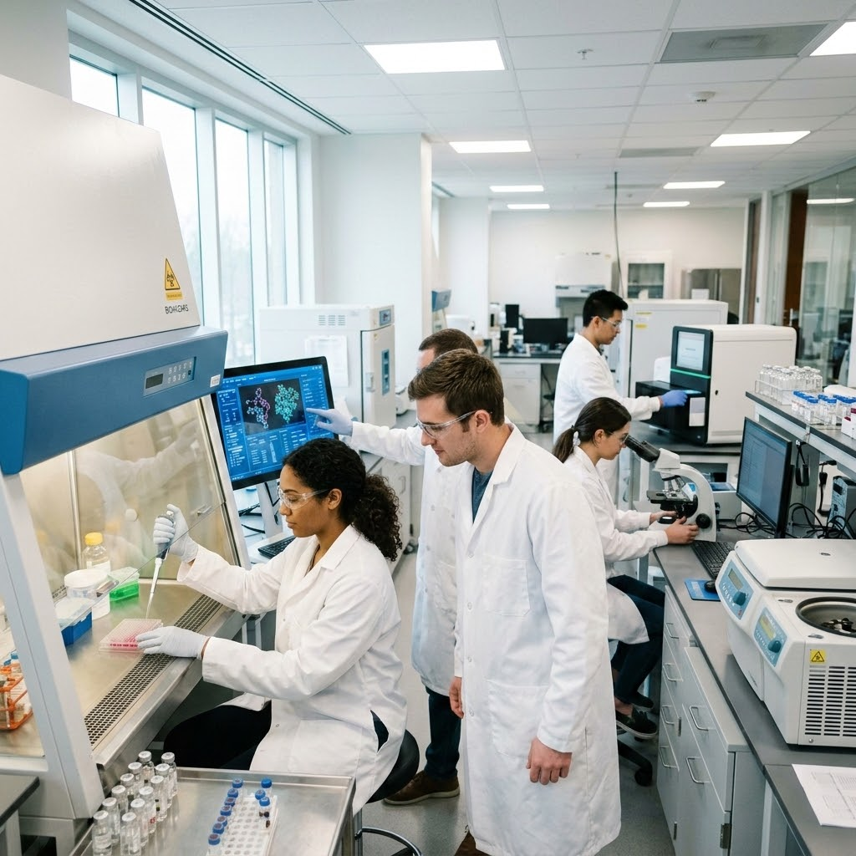
Delivering Future-Ready Graduates
The Faculty's strategy demands graduates who are "career-ready" and can solve complex global problems. Concurrently, the Forethought Market Scan insists on deeper integration of digital and AI skills.
Data-Driven Future-Readiness: COMPASS evaluates curricula to ensure they map correctly to future-proof skills.
Leading, Not Lagging: Shifts reliance from historical placement data to leading, real-time hiring signals.
Assurance of Employability: Complements academic quality assurance with rigorous market relevance.

Slide 5






The 11 Dimensions of Durability
COMPASS evaluates programs across critical dimensions scored 0–3, separating academic quality from true labor-market durability. Key dimensions include:
Automation Exposure
Systems Thinking
AI Governance
Maps the first 5 years of graduate work directly to current AI automation capabilities to identify displacement risks.
Differentiates graduates who can design complex solutions and frame problems from those who merely execute templates.
Assesses whether the curriculum instills accountable judgment and decision-making under uncertainty.

Slide 6



Integrated Capabilities
Market Intelligence
Curriculum Redesign Advisor
Generates a real-time scan of relevant job families, recent hiring signals, and current professional discourse.
Converts assessment scores and market evidence into an actionable, prioritized improvement plan.
Value: Anchors the assessment in live labor-market evidence rather than static accreditation frameworks, fulfilling the need for stronger industry integration.
Value: Provides curriculum teams with interventions, owners, timelines, and measurable KPIs, drastically accelerating the review process.

Slide 7

Supporting "In-Flight" Initiatives
COMPASS acts as a diagnostic engine that can immediately accelerate the Faculty's active projects.
BSc Majors Renewal: Run comparative risk assessments on legacy majors versus newly proposed 2027 structures to quantitatively validate improvements.
Assurance of Learning: Act as an "Assurance of Employability" layer, proving program-level assessments map to market skills.
Process Improvement: Plug into revised curriculum change processes as an automated, evidence-gathering first step.

Slide 8
Questions & Discussion
How can COMPASS best support your immediate 2026 priorities?
David Mulholland

